Slide 1
Acupuncture Usage per Patient
Only includes acupuncture visits administered in VA facilities

Slide 2
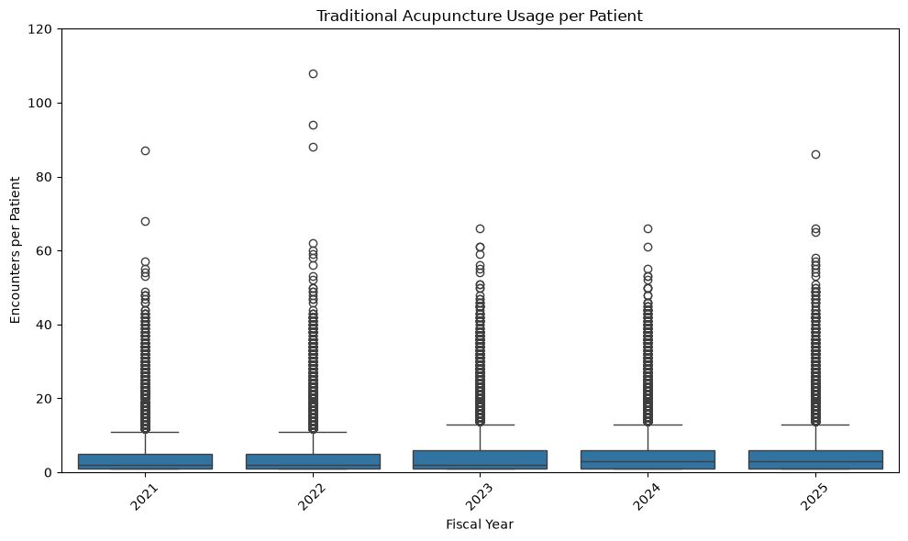
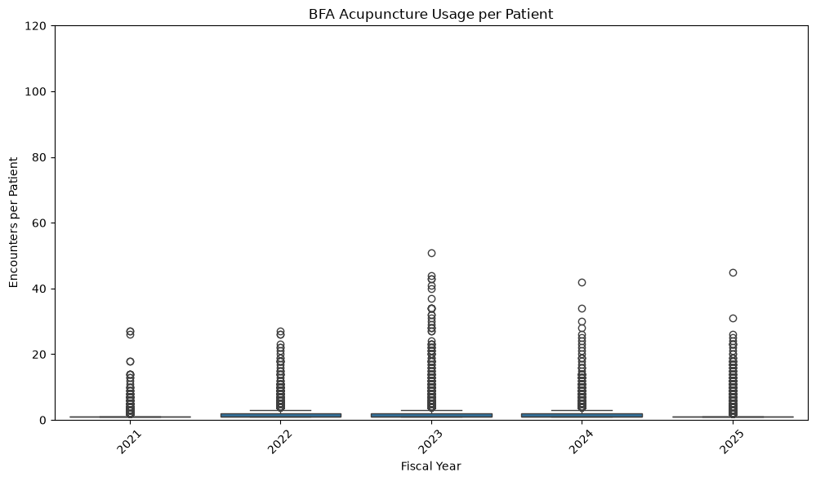
Acupuncture Usage per Patient by FY
Acupuncture has some extreme usage outliers
QA’d some highest usage patients and they seem to be real people
As expected, average BFA usage per patient is lower

Slide 3
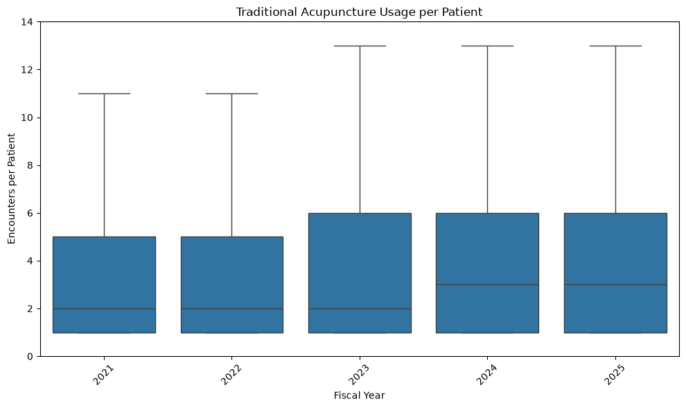
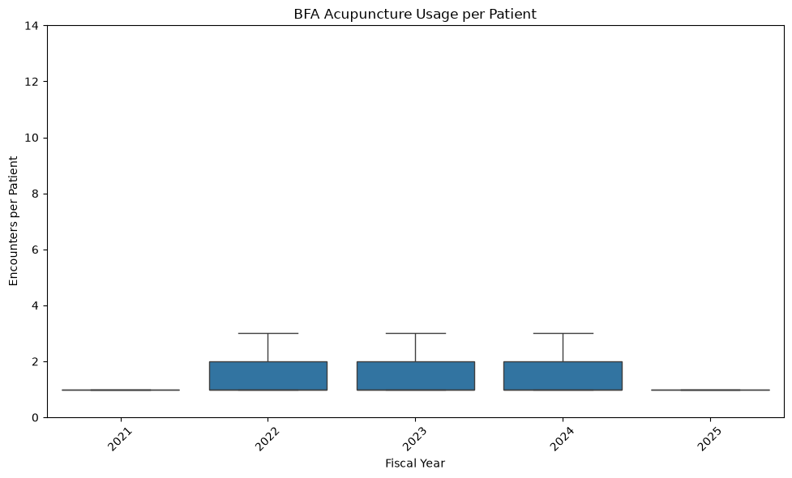
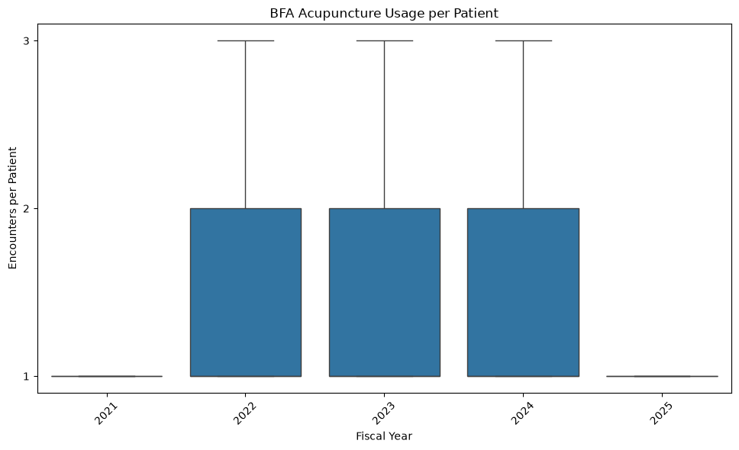
Acupuncture Usage per Patient by FY – removed outliers
Usage per patient has remained consistent by FY

Slide 4
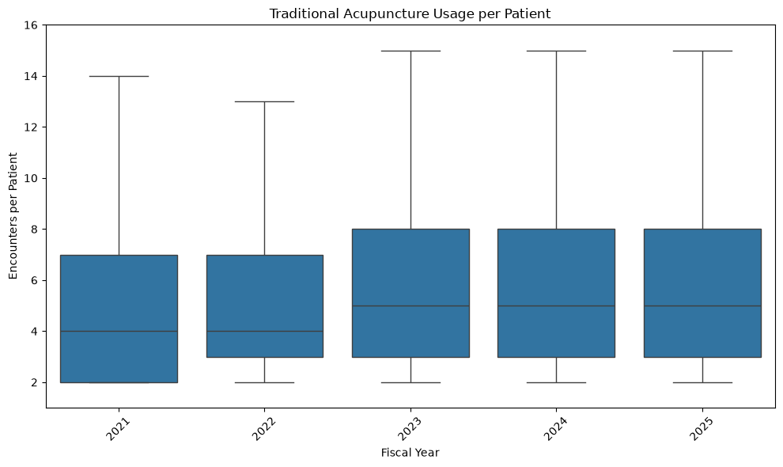
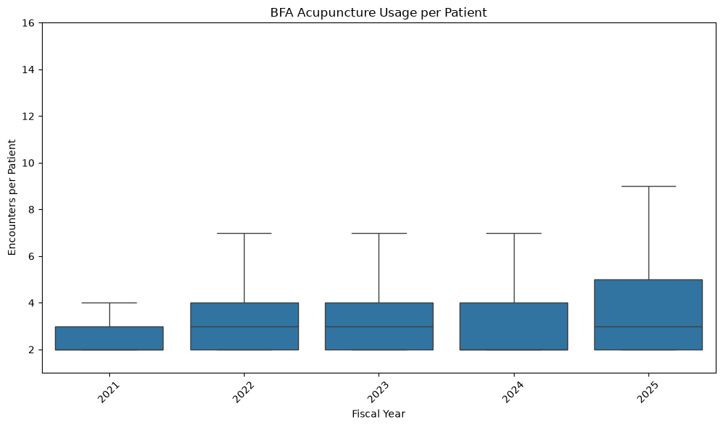
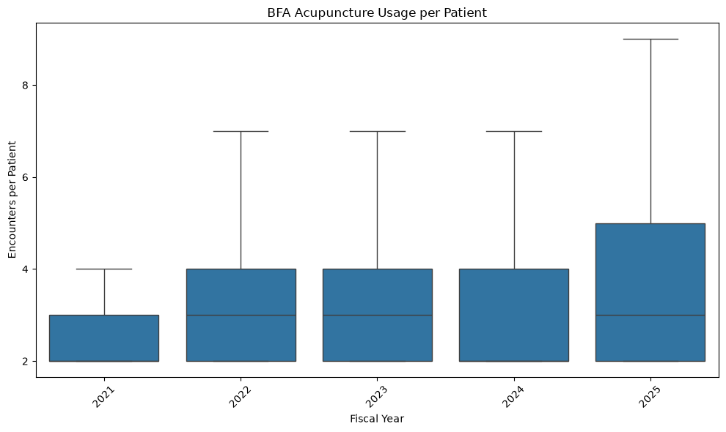
Acupuncture Usage per Patient – only return patients & no outliers displayed
There are 377,000 patients who have received acupuncture treatment (any variety) at a VH facility since FY21. Of those, 262,000 had at least 1 return encounter (69%). The actual return rate may be higher if patients began seeking treatment at community care facilities

Slide 5
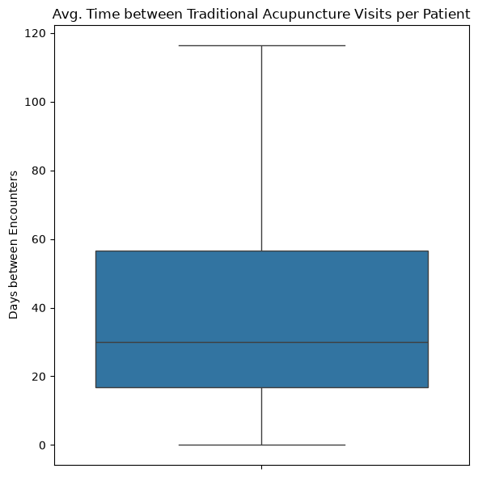
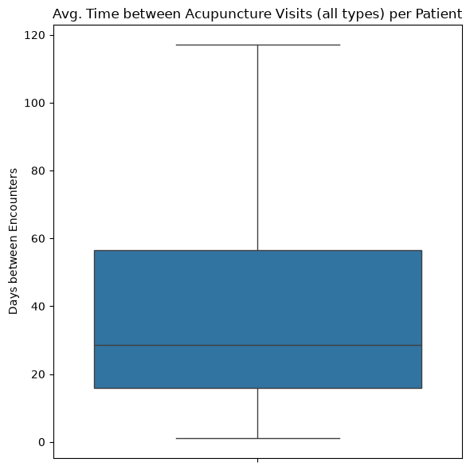
Average Time between Traditional Acupuncture Visits
Excludes outliers and times between visits >365 days (assumed to be different events for treatment)
Median time between encounters is 30 days
Only accounts for traditional acupuncture encounters at VA facilities
Not really relevant for this slide but 52% of patients 1st receiving BFA later receive traditional acupuncture

Slide 6
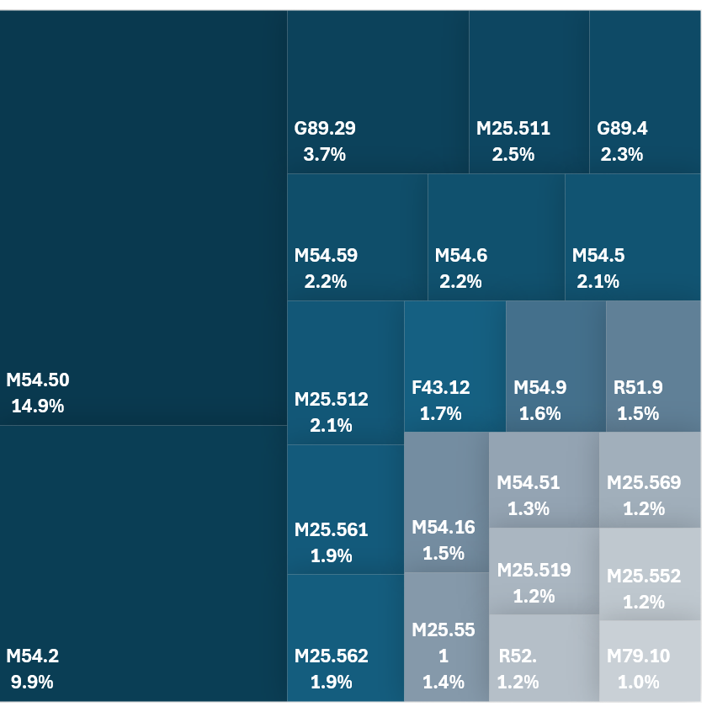
ICD10 Codes Associated with Acupuncture Visits
Shows ICD10 codes that appear in at least 1% of acupuncture encounters
ICD10 codes not shown represent 40% of the total ICD10 codes associated with acupuncture visits

